Slide 1




Things Dissembled
Dikshita Desai
WTM Goa

Slide 2


Slide 3

Robotics?
Complicated & Repetitive tasks with precision and accuracy.

Slide 4
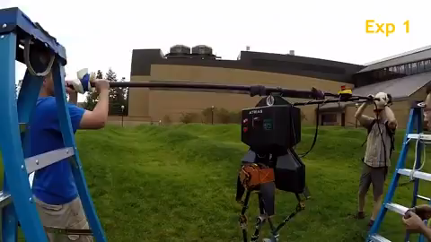

Slide 5
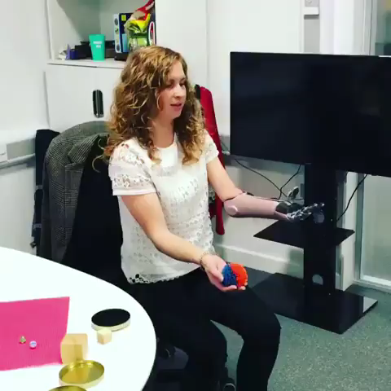

Slide 6
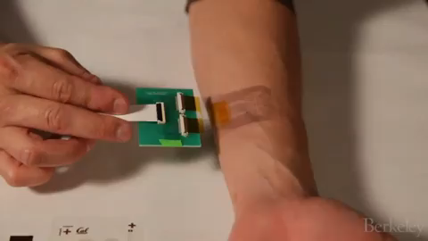

Slide 7
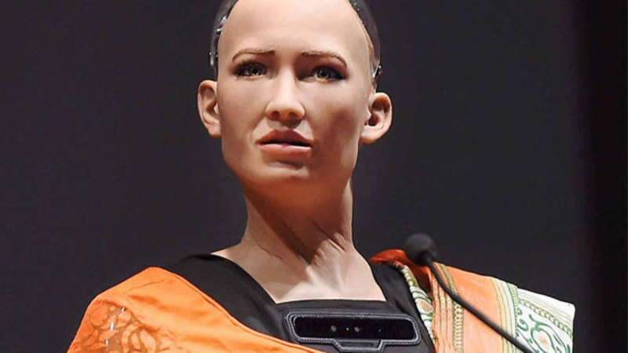
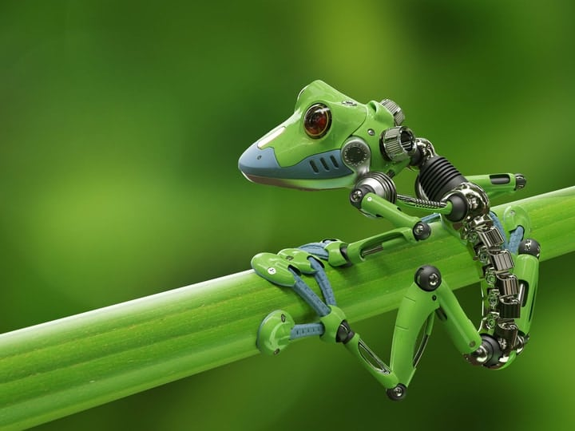
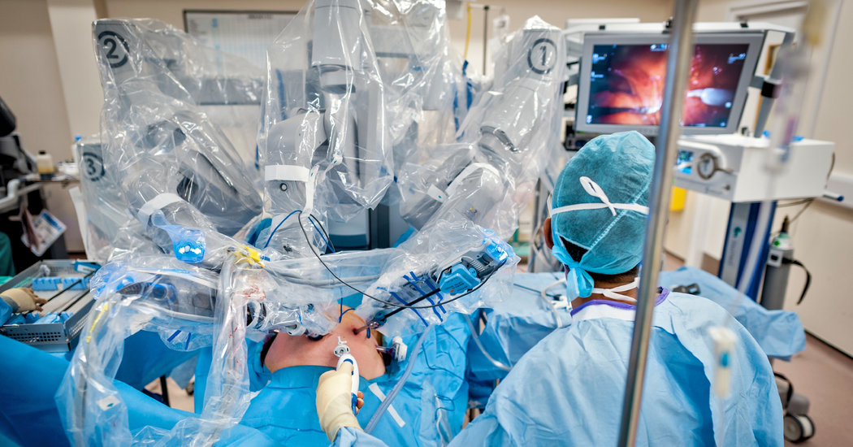

Slide 8

What’s with these Arduino Boards?

Slide 9
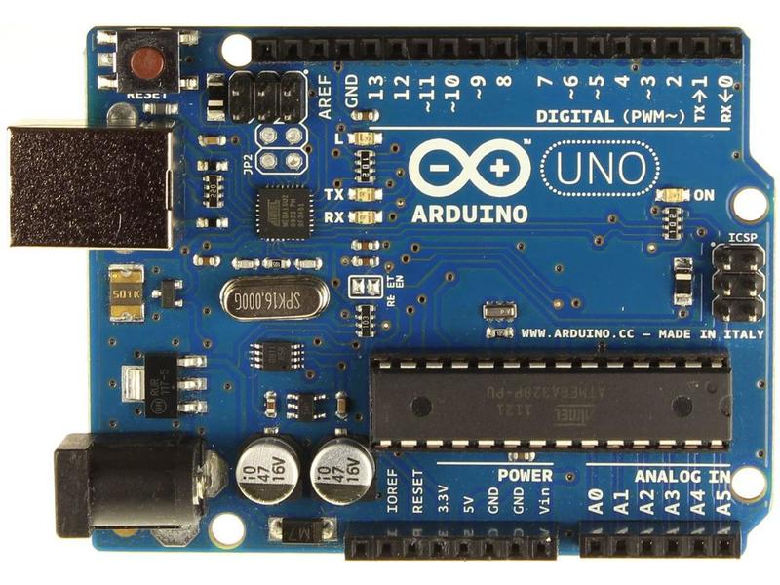

Slide 10
https://create.arduino.cc/getting-started/plugin?page=2

Slide 11
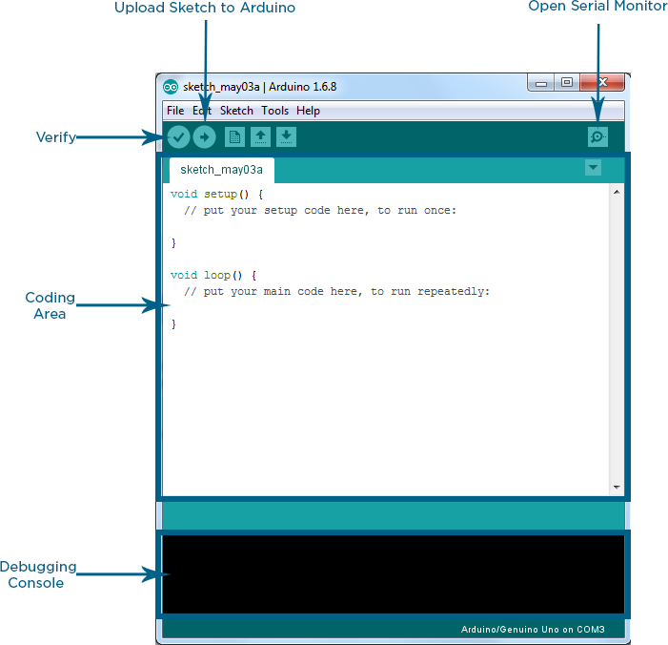

Slide 12
Keywords?
Pin
Mode
Analog
Digital
Read
Write
Input
Output

Slide 13
void setup() { pinMode(LED_BUILTIN, OUTPUT); } void loop() { digitalWrite(LED_BUILTIN, HIGH); delay(5000); digitalWrite(LED_BUILTIN, LOW); delay(1000); }

Slide 14
Thank You

